Slide 1


#SDI.Next: Een nieuwe generatie geostandaarden
Linda van den Brink
20 juni 2019
@brinkwoman
l.vandenbrink@geonovum.nl
#DataToBuildOn

Slide 2

Standaarden voor het uitwisselen van geo-informatie: al bijna 20 jaar…
WMS: April 2000
GML: Mei 2000
WFS: Mei 2002
ISO19115: 2003
ISO19119: 2005
Geospatial domain
Rest of the world
In de geowereld vormt deze set standaarden de basis voor de Geo-informatie Infrastructuur a.k.a. de “Spatial Data Infrastructure”.

Slide 3

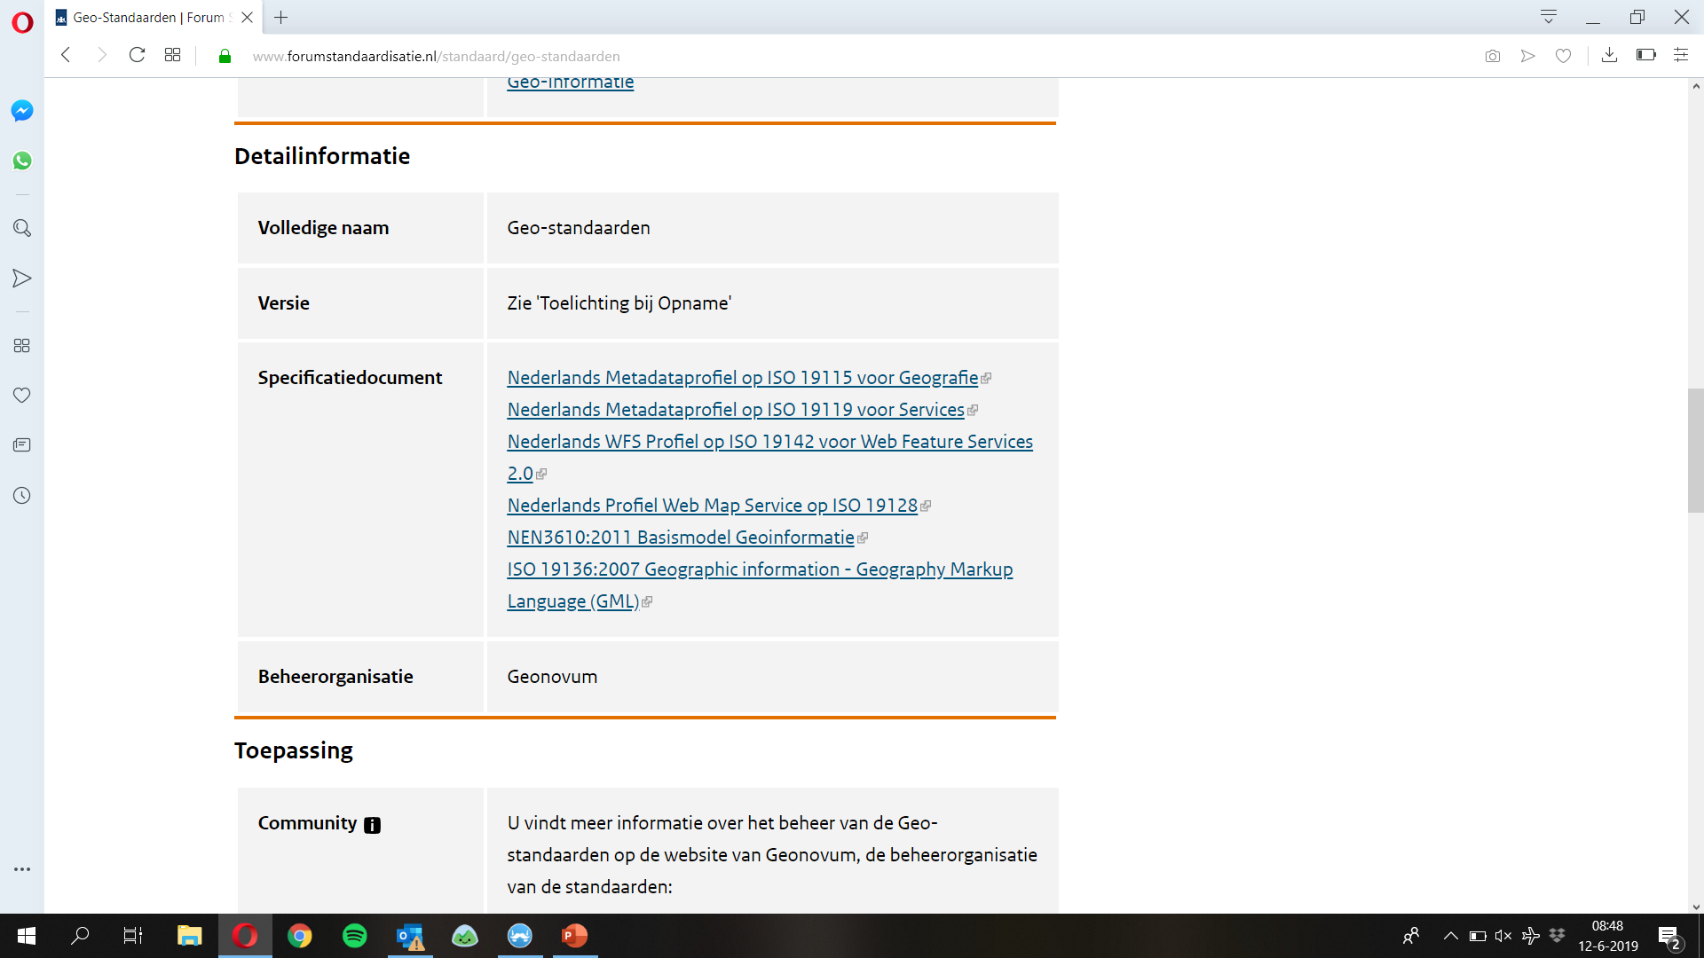
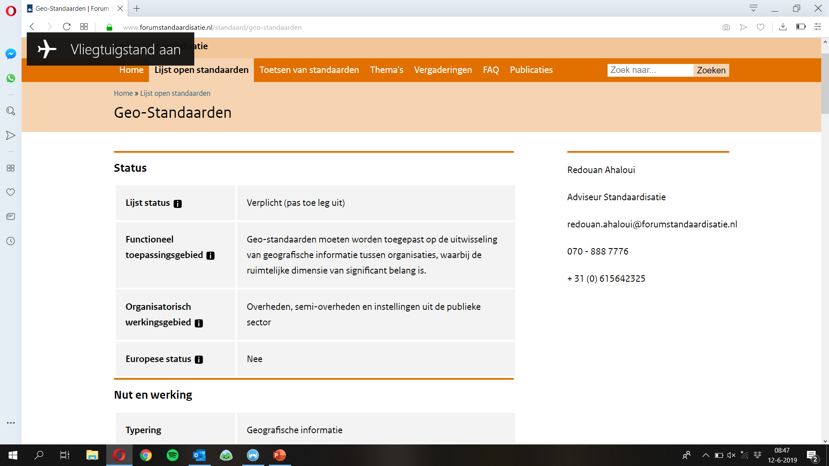
Pas-toe-of-leg-uit
ISO19115
ISO19119
WFS
WMS
GML

Slide 4

Ik kan de data niet vinden met mijn favoriete zoekmachine ☹
Ik geb geweldige data! En open! ☺
Ik kan de data niet gebruiken vanwege ingewikkelde standaarden die ik niet ken en mijn tooling niet ondersteunt ☹

Slide 5
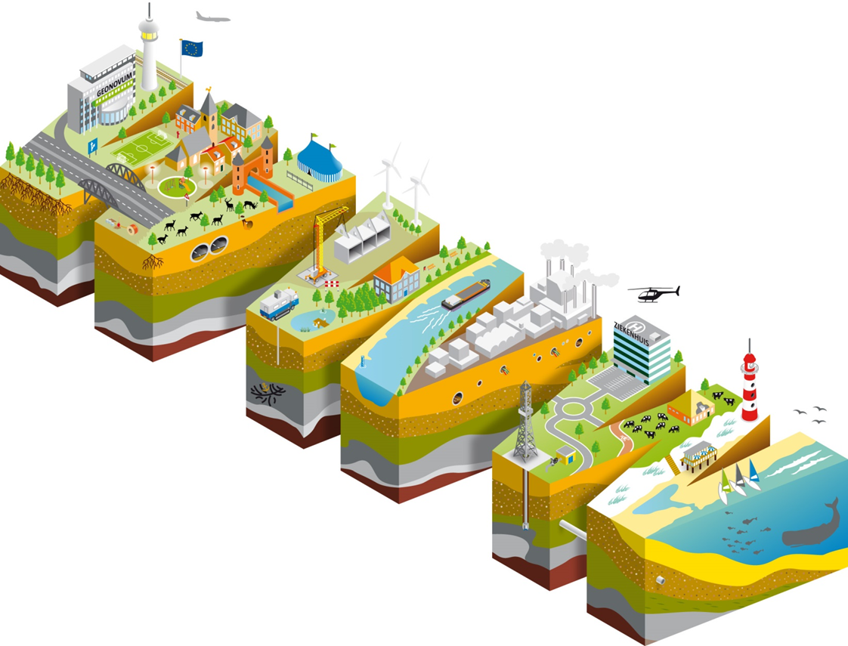
Het doel van SDI.Next: zorgen dat de geostandaarden gaan aansluiten bij het Web platform:
zoekmachines
browsers
HTTP (en HTTPS)
hypermedia / Web links
content negotiation
openAPI metadata

Slide 6

Notes:
Last year, the joint OGC / W3C Spatial Data on the Web Working Group published a set of best practices to help data publishers do just that.
Editors included both myself and Jeremy Tandy from MetOffice UK.
So - to help you understand the Webby approach better, I wanted to highlight a few of the essential concepts…

Slide 7
Gebaseerd op de Linked Data benadering zoals beschreven in het
WEB-DATA 5-sterren schema:
★
★★
★★★
★★★★
★★★★★
Linkable: use stable and discoverable global identifiers
Parseable: use standardized data metamodels such as CSV, XML, RDF, or JSON.
Understandable: use well-known or at least well-documented vocabularies/schemas
Linked: link to other resources whenever possible
Usable: label your document with a license

Slide 8


Bijvoorbeeld
Spatial Thing: “Anything with spatial extent, i.e. size, shape, or position, e.g. people, places, bowling balls, as well as abstract areas like cubes” [W3C_BASIC_GEO]
… een 5 meter hoog oranje standbeeld van een man met zijn mobieltje
(Oranje Man, Cité Centre de Congrès de Lyon)
Notes:
Example – a spatial thing

Slide 9
https://www.wikidata.org/wiki/Q57783921
Best Practice 1: Use globally unique persistent HTTP URIs for Spatial Things
Notes:
So here we see a URL for the actual Orange Man in Lyon. I can talk about the Orange Man in my documents using the URL as a reference.
Obviously I can’t actually download the Orange Man through my browser (that would be magic!), so instead, the Web server will send me some useful information that describes the Orange Man.

Slide 10
https://www.wikidata.org/wiki/Q57783921
Best Practice 2: Make your spatial data indexable by search engines
HTML page with data embedded
e.g. schema.org
Notes:
To make the orange man findable through search engines, we publish some information at the URL. An HTML document that a web browser will render in readable form for humans; with embedded structured data for crawlers and other user agents.

Slide 11
https://www.wikidata.org/wiki/Q57783921
Best Practice 3: Link resources together to create the Web of data
https://www.wikidata.org/wiki/Q456
Resource about City of Lyon
HTML page with data embedded
e.g. schema.org
Link: next page
Link: prev page
Link to related resource
Notes:
Then we link the information to other interesting resources

Slide 12
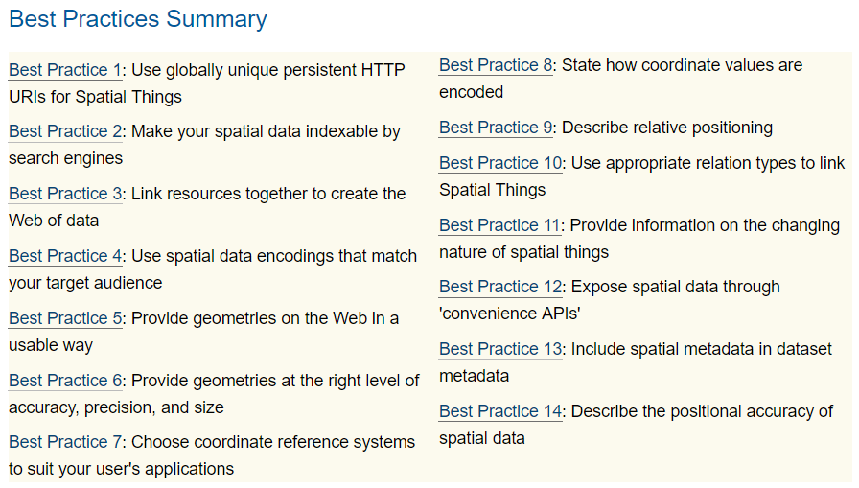
There’s more…
Web principles
Spatial aspects
Access
Spatial aspects
Metadata
Notes:
Those were just illustrations of the first 3 best practices described in our document. There are 14 in total.

Slide 13

“WFS 3.0”: OGC API – Features
Compliant with Spatial Data on the Web Best Practices
Photo by Christian Bowen on Unsplash

Slide 14
Data format: GeoJSON
2019
RESTful –
e.g. HTTP GET instead of
WFS 2.0 GetFeature
Created in open process with developers
… and HTML
OGC API - Features - Part 1: Core, First Draft Release
a.k.a. WFS 3.0
Content negotiation
WGS84
WFS 3.0 core (stable draft)
Requesting datasets (collections)
Requesting data based on id, bbox, time
Paging
Extensions under development
Uses OpenAPI specification

Slide 15
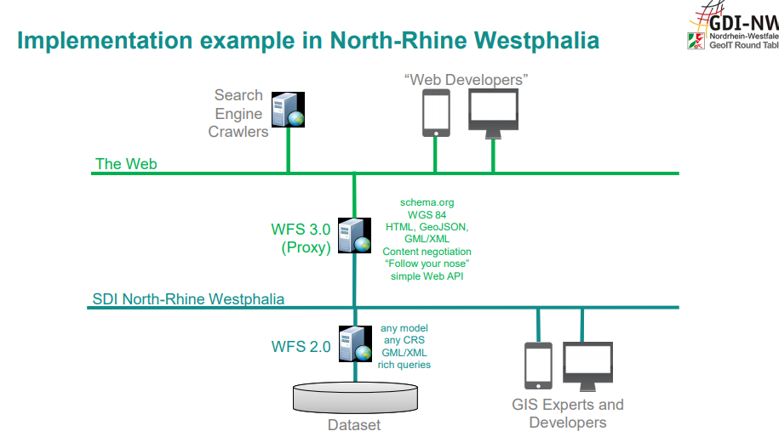
Implementaties beschikbaar
“Results of OGC Testbed 14 indicate the simple core of WFS 3.0 specified as OpenAPI can be implemented rapidly by software developers, and deliver geospatial feature resources secured by OpenID Connect and OAuth 2.0.”
ldproxy
GeoServer plugin
pygeoapi
Slide van Clemens Portele

Slide 16


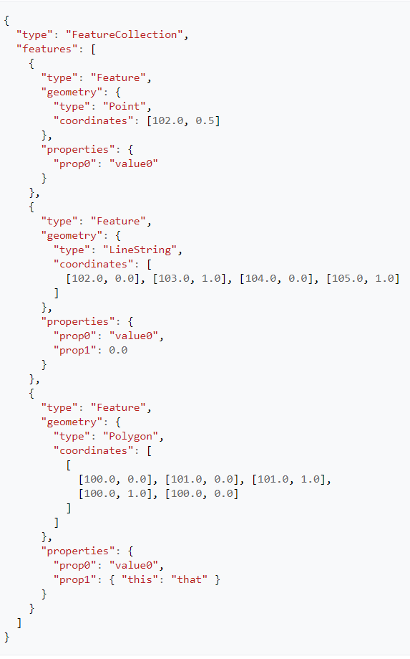

{GeoJSON}
</GML>…?
Bron: wikipedia

Slide 17
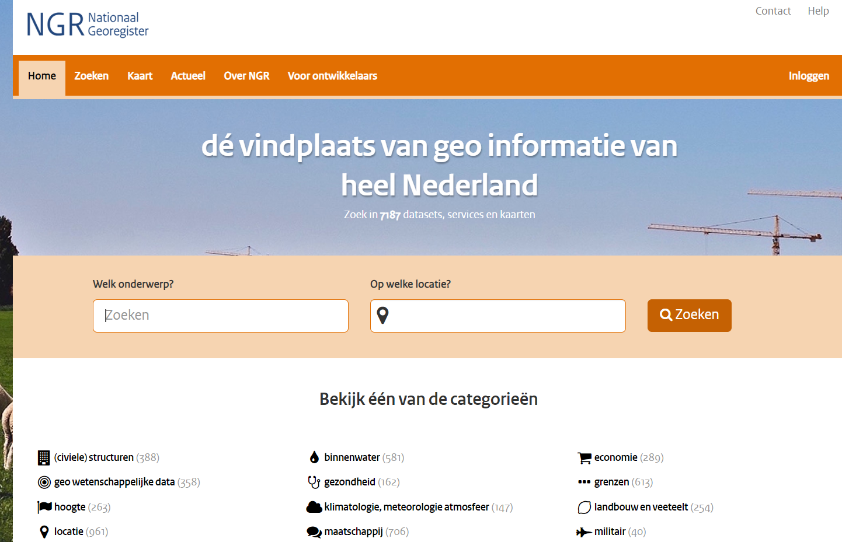
https://toolbox.google.com/datasetsearch
ISO 19115 Dataset beschrijving
ISO 19119 Service beschrijving

Slide 18
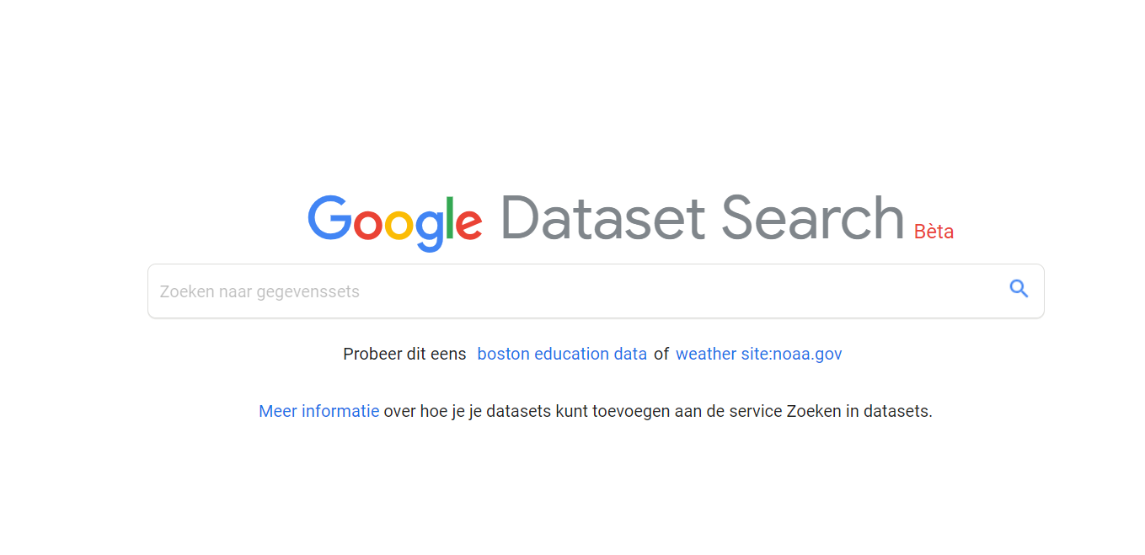
https://toolbox.google.com/datasetsearch
- Data Catalog Vocabulary - (DCAT 2.0) - Schema.org - - OpenAPI specification -

Slide 19
SDI.Next ontwikkelingen
Bijeenkomst ‘lichtere formaten’ (24 mei), focus op GeoPackage en GeoJSON
Experimenten gestart in combinatie met WFS 3.0 experimenten
GeoPackage wordt toegevoegd aan Pas-toe-of-leg-uit lijst
WFS 3.0 werkweek (3-6 juni)
Vector tiling – sessie tijdens Open Geodag (Geonovum’s netwerkdag) – 2 oktober
NEN 3610 Linked Data profiel
Platform Linked Data Nederland (ongoing)
Kennisplatform API’s (ongoing)

Slide 20
Linda van den Brink
@brinkwoman
#DataToBuildOn
l.vandenbrink@geonovum.nl

